Slide 1

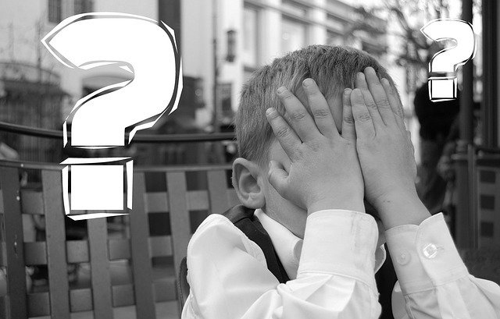
Facial Recognition: Dystopian Dreams of China?
Audience: UN Security Council
July 18th, 2018
Miguel Jaime, Prabhat Tripathi, Tiffany Truong, Debalina Maiti
Notes:
Debalina:
Facial recognition Technology is now the most recent advancement of AI. A facial recognition system is a technology capable of identifying or verifying a person from a digital image or a video frame from a video source. There are multiple methods in which facial recognition systems work, but in general, they work by comparing selected facial features from given image with faces within a database.
China has already progressed a lot in this field. There are several pros and cons and so is the controversy. In our presentation we will discuss on this controversy.

Slide 2
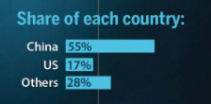
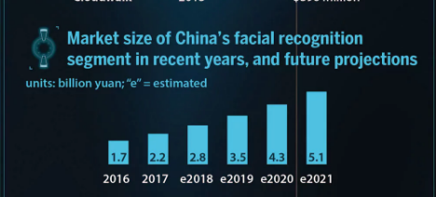
China’s Facial Recognition Advances
World’s largest surveillance network with 170M Camera, 4 times that of US
Crime Fighting
Giant Database to recognise ANY citizen in seconds
Smile to Pay :)
Investment on Facial Recognition
Notes:
Debalina:
China’s target is to make surveillance network omnipresent nationwide by 2020. They claim that already they have implemented this technology so massively it can recognize any of 1.3B people in just a second.
Crime Fighting, Gambling Problem Assistance, Flight Check-in System, Face-to-pay, Exam surveillance are to name a few from thousands of facial recognition advancement.

Slide 3
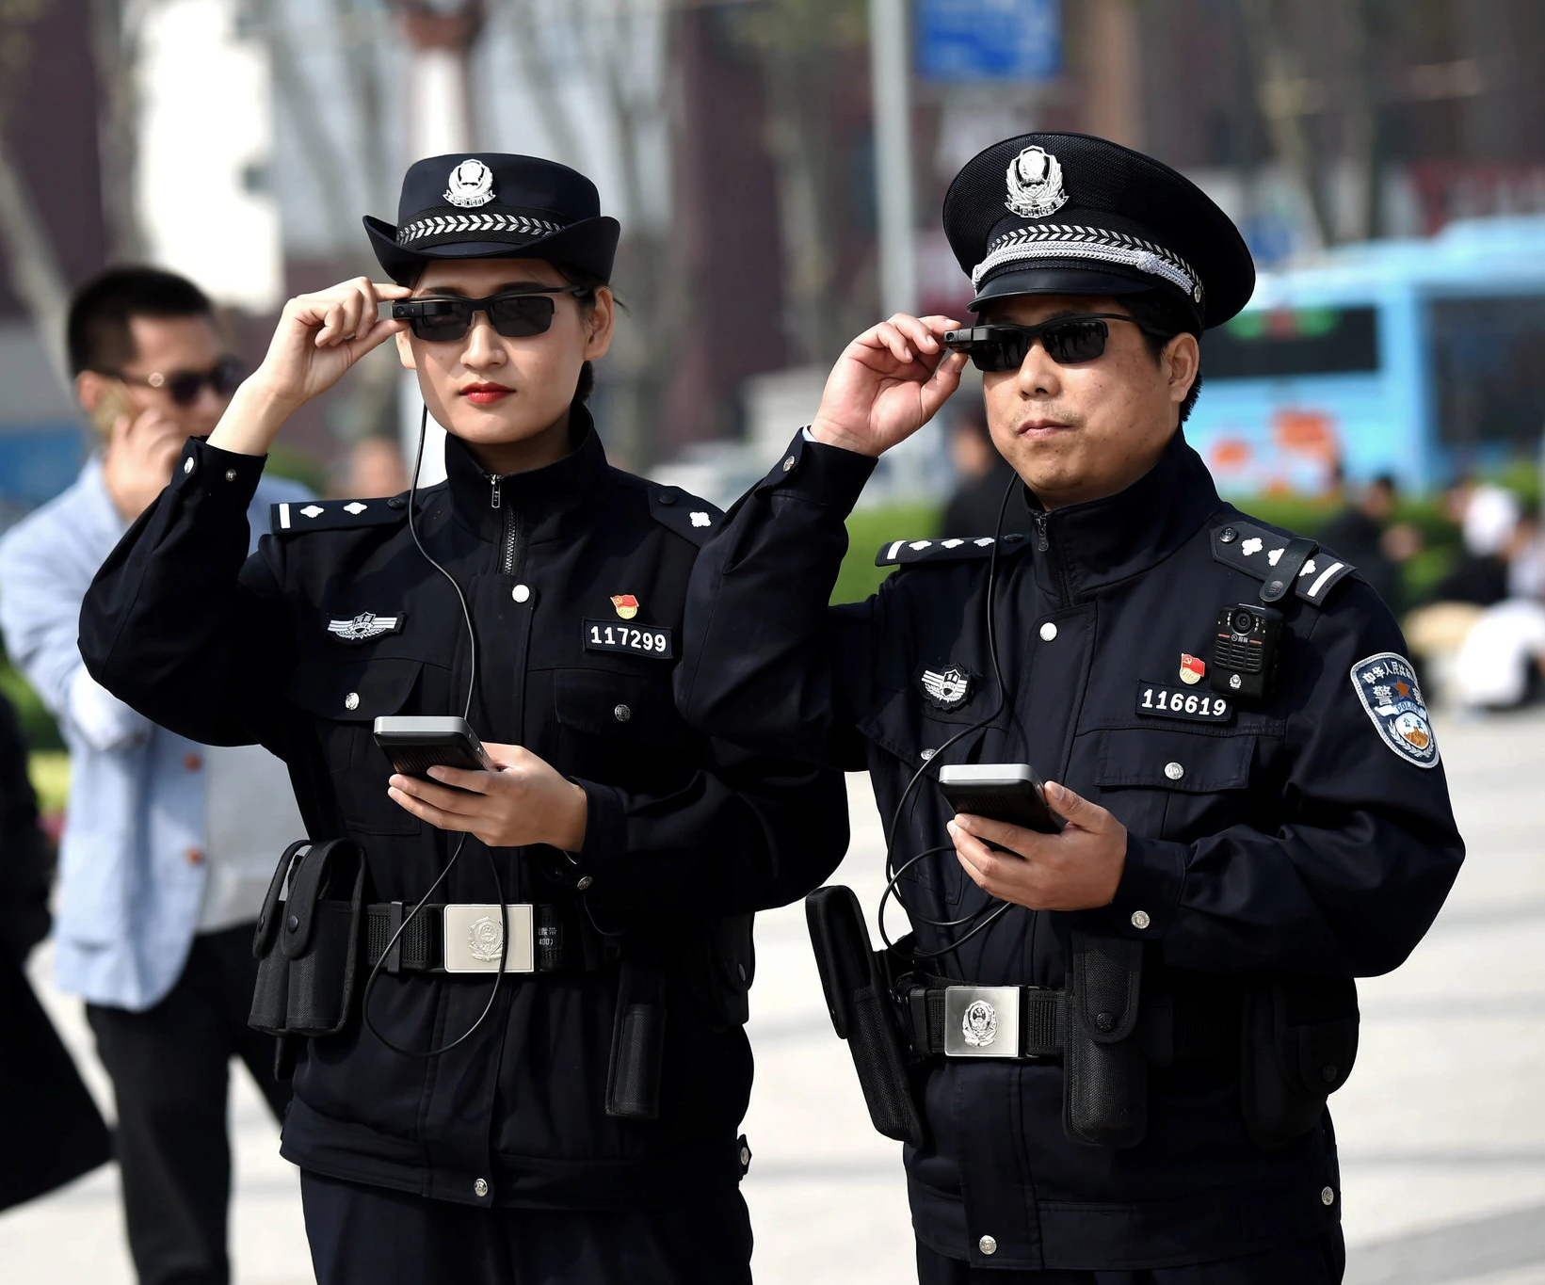
Pros: The Chinese Government’s Perspective
Facial recognition can aid with police work
Identifying and apprehending known criminals through...
Surveillance data
Experimental uses
Better security at major events
Potentially, crime prediction
Notes:
TK:
The greatest benefit from facial recognition technology is more effective policing. Because of the amount of data available, Big Data police systems are able to effectively track criminals. In particular, one system, SkyNet, is in use at over 20 airports and train stations. Since its adoption, police have caught more than 1,000 criminals through its use. The state-controlled media often highlights statistics like this to demonstrate the benefits of such surveillance. However, some important details, such as what they mean by criminals as well as their alleged crimes, are often undisclosed. These systems have also been used to analyze crowds and to help with crime prediction, such as identifying thieves on a train.
The Chinese police are also experimenting with other uses, which you can see from this photo here. These officers are using glasses with facial recognition capabilities. So far, they have been mainly used at train stations to identify travelers with false documentation, but there is potential to do much more.

Slide 4
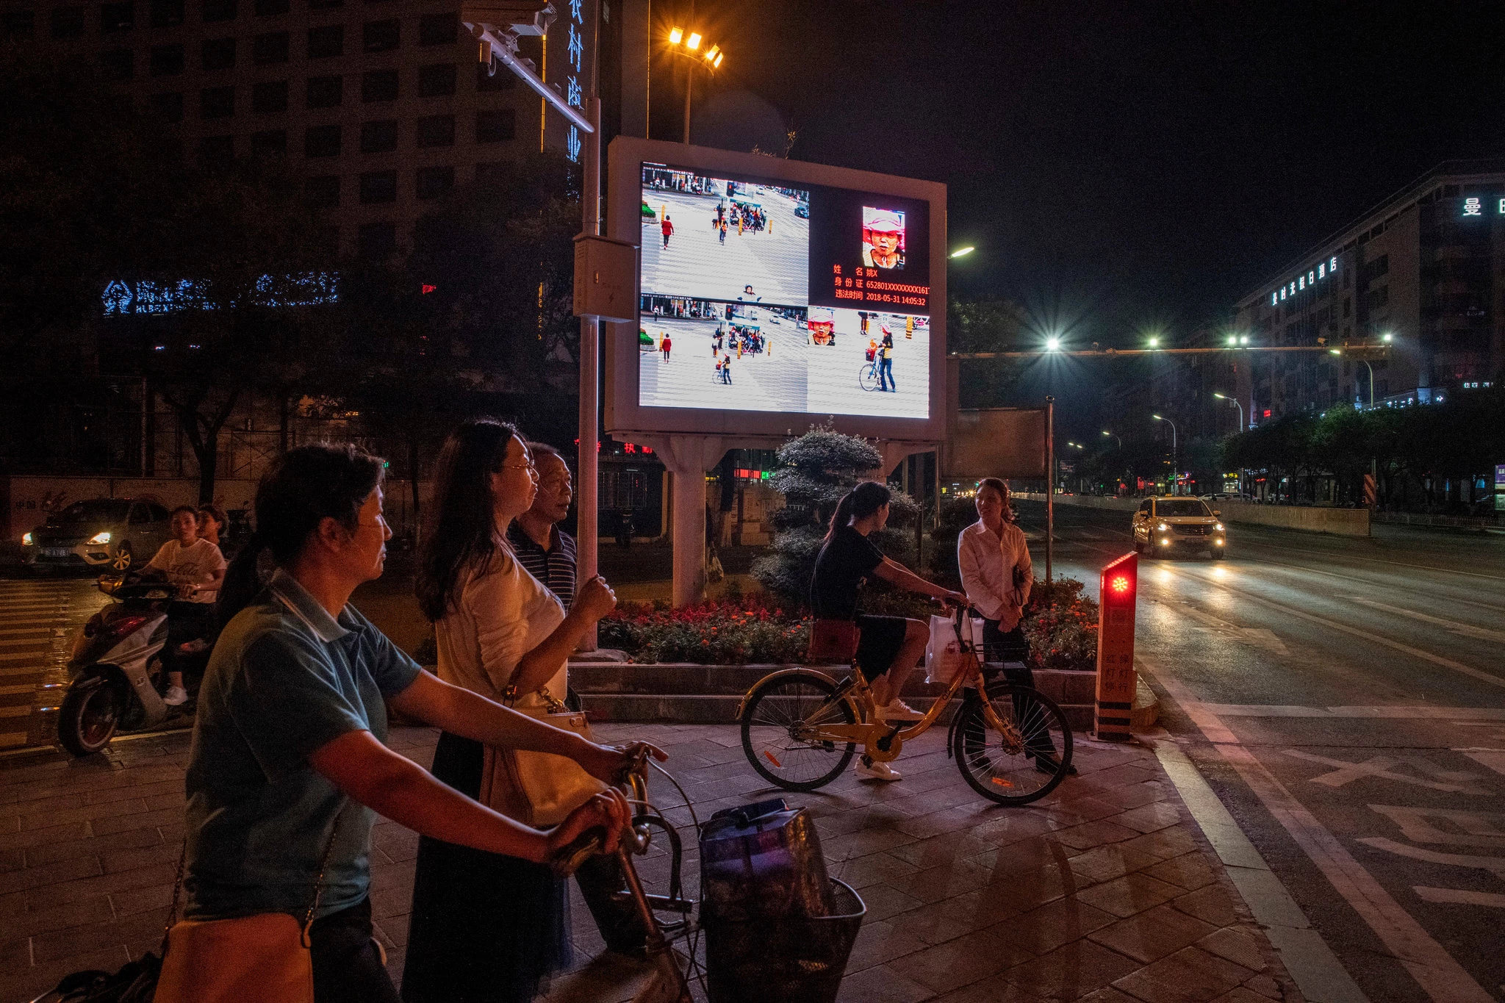
Notes:
TK:
While this technology is very advanced, the Chinese authorities, rely on the effect being observed to discourage crime. Here’s an example. This busy crosswalk used to be very difficult to police because of traffic and pedestrian jaywalking. In 2017, police installed cameras as well as this big screen that you see here. Now if someone jaywalks, their image is captured and displayed on the screen along with their information. A spokesperson said that the embarrassment from potentially having others see your image on the screen will deter people. There is actually a lag time of a few days for a jaywalker’s image to be displayed, but the threat of that happening has had a profound effect. Indeed, the amount of jaywalking at this intersection has decreased, which police attribute to the surveillance. Aside from the actual capabilities of the technology, the government assumes that the feeling of being watched alters people’s behaviors for the better.

Slide 5
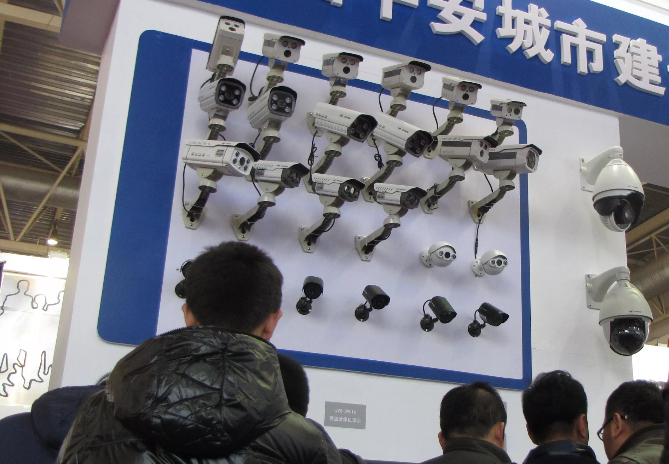
Pros: The Chinese Government’s Perspective
Investment in this area bolsters the Chinese technology industry
Government contracts fuel R&D
Rise of startups to meet the demand
Global interest in surveillance products, specifically facial recognition
Notes:
TK:
In 2017, domestic security accounted for 6% of government spending in China, including many technology initiatives. Demand in this area has led to the rise of numerous startups such as Eyecool, which developed SkyNet, as mentioned earlier. Government contracts fuel research and development resulting in innovative experiments like the glasses. Many companies are also looking into further refining the technology to track clothing and a person’s gait. These startups continue to raise hundreds of millions from investors as they expand their business beyond China--to Southeast Asia and the Middle East.

Slide 6

Cons: Mass (untargeted) Surveillance
Privacy and Civil Rights
No opt-in / opt-out
Lack of effective Privacy Protection
Civil rights
Independent and Critical freedom of expression
Surveillance begets more surveillance
Notes:
PT:
Now that we have talked about some of the arguments in favor of using these Advanced AI and Face Detection by the Chinese authorities, I would like to highlight "key concerns" from using such technology.
With the scope and scale of mass surveillance we are talking about here, the overarching concern is about privacy and civil liberties or rights.
There is no opt-in / no way to opt-out. The way they are using the technology where they display the individual's personal info on the billboards, we see the lack of effective privacy protections.
There is also a risk to forcefully attempt to silence independent or critical point of views particularly from civil rights advocates such as activists, lawyers and writers. . This attack of freedom of expression has huge ramifications because as we see freedom of expression is one of the fundamental rights.
This fear of mass surveillance, in a long run, would stymie freedom and independent and critical expression in the society, creating totalitarian regime.
Law of accelerated returns => increased Surveillance
Surveillance => Data Explosion => Algorithm improvements => More Surveillance
AI based systems tends to get better as more data is fed into them making this surveillance even more intrusive in the future.
Mass Surveillance usually has accelerated returns in that wider and more intrusive surveillance begets more data which improves AI/prediction and that makes an argument for even more surveillance.

Slide 7
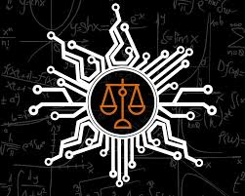
Cons: Algorithmic Biases
Fairness and False-positives
False positives and due process
Algorithmic fairness
Confirmation Bias
Minority rights
Notes:
PT:
As we know, AI systems and algorithms are prone to biases and are difficult to guarantee fairness and may hinder due-process rights.
Any false positive convictions or punishments further exacerbate human rights concerns.
Algorithmic fairness is hard to judge and audit.
Specifically, the algorithms may be disproportionately skewed toward minority rights such as Chinese Muslims.
For minorities, there is also danger of confirmation bias where disproportionate surveillance of a minority group (say Chinese Muslims) will give biased data to show that crime rate is higher is that community prompting more surveillance to the community.

Slide 8
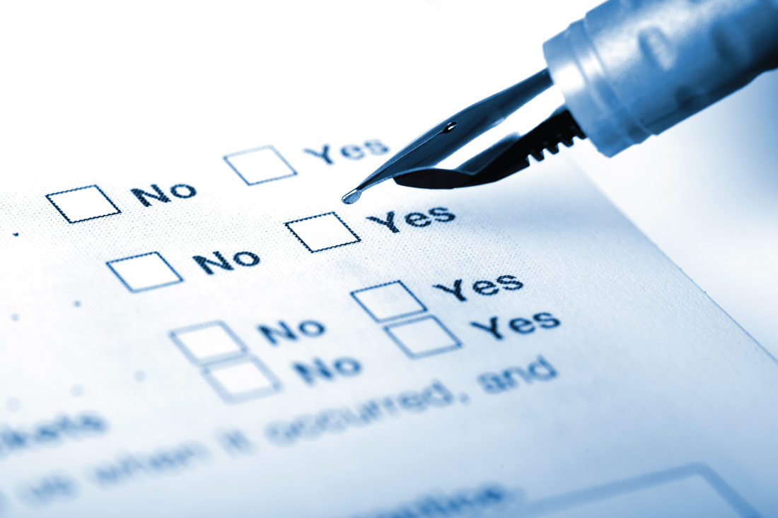
Who Will Win
Fantastic initiative by government
Points to consider:
Errors can be fatal
Misuse / Shame Game
Personalized ad targeting
Different cultural behavior
Anti-Facial Recognition Systems
Are people ready for it?
Notes:
Debalina:
As there is no opt-in/out option, this technology has to be absolutely error free. Though the error rate is really less <0.8%, even that can be fatal and has a very high probability of convicting an innocent.
Technology is meant for betterment of human being. So misusing this to shame a person has to be avoided.
Facial Recognition tech can benefit Personalized Ad Targeting enormously. At the same time that can be direct hindering of people’s privacy. So this has to be controlled.
Though positive side of facial recognition is that it can work from distance, taking photo without informing a person might hurt some cultural behavior. So this aspect has to be handled with care
Japanese researchers from the National Institute of Informatics created 'privacy visor' glasses that use nearly infrared light to make the face underneath it unrecognizable to face recognition software. This can be dangerous unless taken proper attention.

Slide 9
Justice at Scale
Law and order vs. individual rights
Solutions at scale require safeguards at scale
A framework with three pillars:
Independence
Fairness
Transparency
Notes:
We propose a compromise to deliver justice at scale.
Using technology to uphold the rule of law is not inherently bad
But it’s a balancing act: society’s need for law and order and individual rights.
Something as consequential as law enforcement, when deployed at scale, will require safeguards at scale
We suggest a framework for ethical use of big data in law enforcement based on three pillars.
-Independence
-Fairness
-Transparency

Slide 10
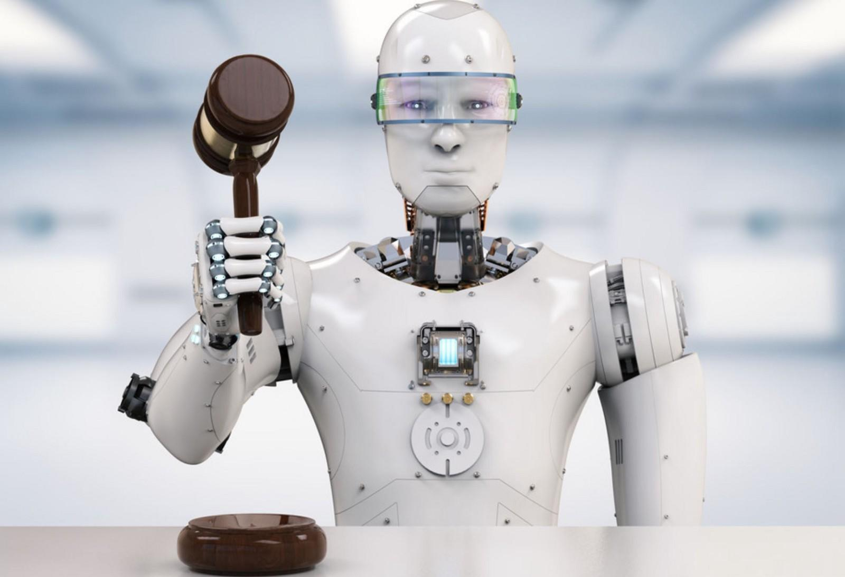
Independence
Independent from state apparatus
Binding rulings on citizen complaints
Data custodian
Notes:
First pillar is independence.
We propose creating an independent committee to oversee the use of data by law enforcement.
It will provide an avenue for citizens to challenge how their data is being used, and will have the power to issue binding verdicts
It will be the data custodian: it will set and enforce policies regarding data use, access and retention. This role will include provisioning, deprovisioning, and auditing access to data.
We know it will require the government to give up a significant amount of control, but believe it’s the best way to deploy surveillance at scale without potential social unrest.

Slide 11
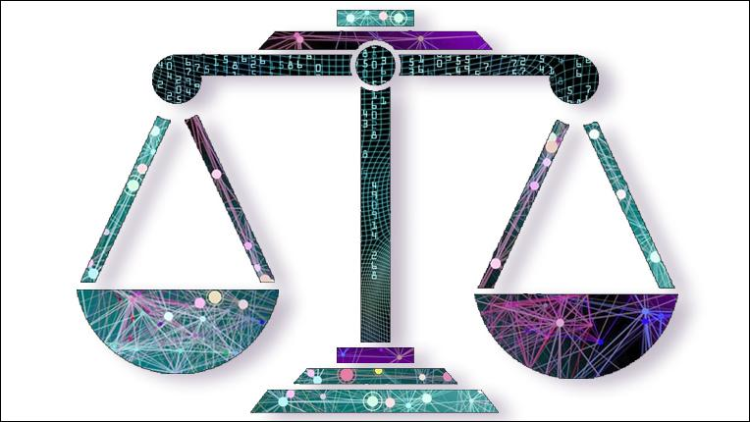
Fairness
Fairness of outcomes, not just of process
Measure statistical parity between relevant categories
Notes:
Second pillar is fairness.
There are many ways in which an algorithm might be biased:
-Biased training data
-Biased data interpretation
Achieving fairness means we use outcomes as a measure, instead of just the process which might result in ignoring biases elsewhere that end up affecting the results.
Another important measure of fairness is statistical parity between certain categories. When this is violated, the solution would be finding out the root causes, and taking action if needed.

Slide 12

Transparency
Individuals have the right to:
Access to one’s digital profile
Understand access, use, and retention of one’s data
Notes:
The last pillar we propose is transparency.
It will consists of granting two rights to all citizens.
1. The right to access their data profile at any time, and understand what the state knows about them, and how that information was obtained.
2. The right to understand how their data is being used. Who accessed it? For what purpose? How was the data used? When will it be deleted?
There would be exceptions to protect criminal investigations and similar situations.
We believe that through independent oversight, algorithmic fairness, and data transparency, law enforcement can deploy these solutions at scale while minimizing the risk of discontent in society.

Slide 13
Thank You

Slide 14
References
Chan, T. (2018, February 12). Chinese police are using facial-recognition glasses to scan travelers. Retrieved from
https://www.independent.co.uk/news/world/asia/china-police-facial-recognition-sunglasses-security-smart-tech-travellers-crimi
als-a8206491.html
Chin, J. (2018, March 07). China dramatically boosts spending on internal security. Retrieved from
https://www.marketwatch.com/story/china-dramatically-boosts-spending-on-internal-security-2018-03-06
Kroll, Joshua A., Joanna Huey, Solon Barocas, Edward W. Felten, Joel R. Reidenberg, David G. Robinson & Harlan Yu. "Accountable Algorithms." University of Pennsylvania Law Review. Vol 165:633
Mozur, P. (2018, July 08). Inside China's Dystopian Dreams: A.I., Shame and Lots of Cameras. Retrieved from
https://www.nytimes.com/2018/07/08/business/china-surveillance-technology.html
https://en.wikipedia.org/wiki/Facial_recognition_system
https://www.guidingtech.com/facial-recognition-good-or-bad/
https://www.telegraph.co.uk/news/world/china-watch/technology/face-recognition-technology/
https://towardsdatascience.com/a-gentle-introduction-to-the-discussion-on-algorithmic-fairness-740bbb469b6

